Slide 1

Hotel Reservation system
Welcome ..

Slide 2
1
2
3
4
5
6
Contents
Overview
State of Art
System analysis
Introduction to our
HRS
Describe some of related systems and comparison
Diagrams and system info
System Design
Implementation
References
System actual grafic user interface(GUI)
The soft and hardware used for implementation
The references & resources we use

Slide 3

What’s out Goal?
To manage a lot of hotels with high quality management
To make our customers satisfy of our service

Slide 4
Why HRS ?
having a hotel reservation system software is the one of the easiest changes a hotel can implement to reap the benefits and improve quality
HOTEL
RS

Slide 5

1
HRS Overview

Slide 6
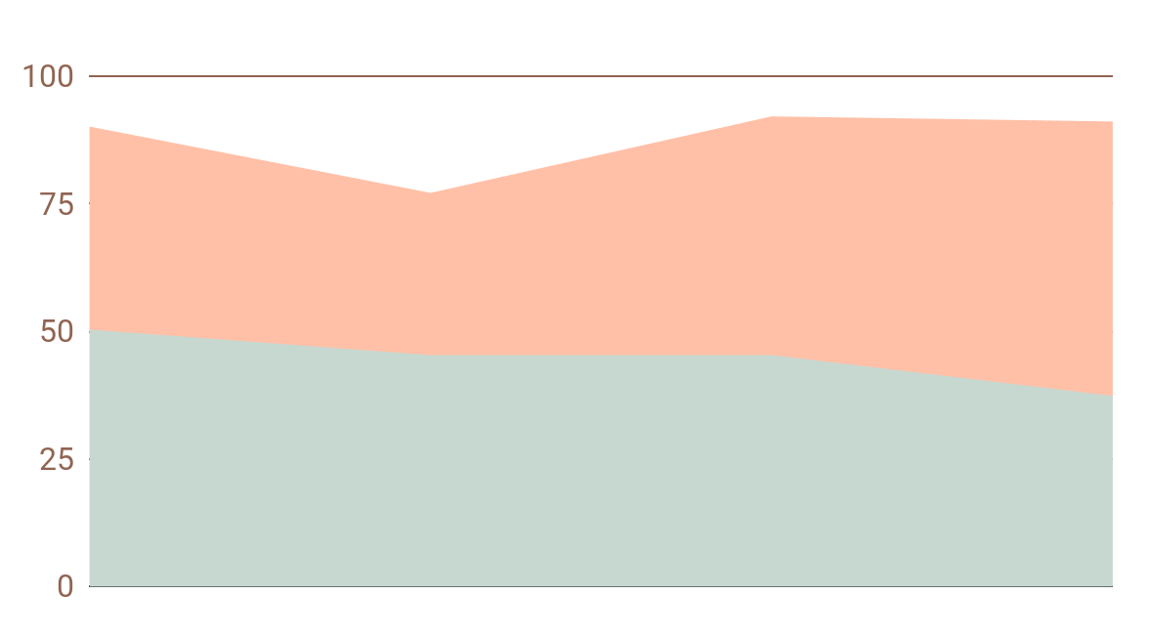
hotels Booking systems in the past and now
1
New Systems
2
Old Systems
Lower cost , more efficiency
As you can see this is a big deffrent in the hotel reservation systems quality in the speed,capacity and customer satisfaction
More cost , low efficiency

Slide 7

Problem
Solution
There’s no software that manage a group of hotels and it’s room with simple GUI
We create a simple web app that manage hotels,rooms and customer services

Slide 8
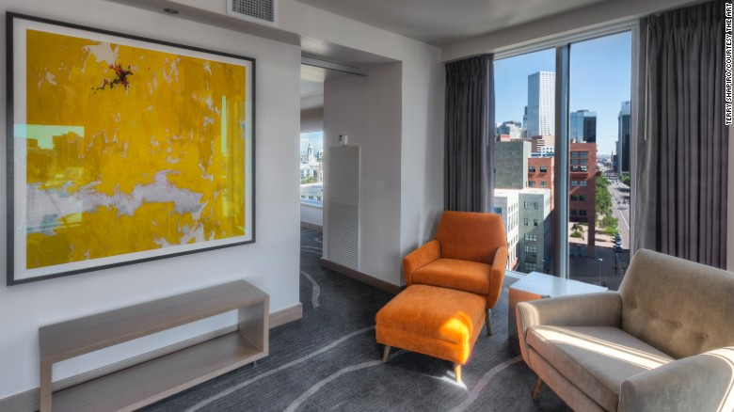
2
State of Art

Slide 9
Related Systems
Vertical Booking
Amadeus
Pegasus CRS
And more ..

Slide 10

Vertical Booking (CRS) Overview Vertical Booking is a leading, global reservation technology provider with hotel clients in 107 countries worldwide, offering solutions translated into 29 languages and usable in all currencies. No matter the size of your property or group, Vertical Booking can provide a customizable solution that supports the entire guest booking cycle - including a booking engine, GDS distribution, channel manager, OTA rate comparison tool and a reservation call center application - all through one integrated CRS dashboard.
01

Slide 11

Pegasus CRS (Cendyn) Overview Take full control of your hotel’s distribution strategy with the Pegasus CRS, an award-winning cloud-based reservations solution that offers unprecedented flexibility, scalability, security and support in managing your rates and inventory. We offer comprehensive connectivity to all major distribution channels, while prioritizing conversion on your most profitable channel: your website. Our five-star support team of revenue, marketing and sales experts works proactively to ensure success for your hotel.
02

Slide 12

Revinate (RezForce Call Center) Overview Our highly trained, expert agents capture bookings when your team is busy or unavailable. We hire train and performance test only the best US-based agents who deliver an industry-leading 99.89% booking accuracy rate for our clients. Every call results in guest lead data to capture second chance bookings and grow your marketing database. With RezForce Lux, agents are trained with Forbes Travel Guide’s 5-Star certification standards, and consistently earn an overall satisfaction score of 99%. Increase profitability by balancing fixed and variable labor costs that flex with your business.
03

Slide 13


Them
Us
Expincive applications that manage only single hotel with limited customers
Less Expincive app that manange multiple operations

Slide 14

3
System analysis

Slide 15
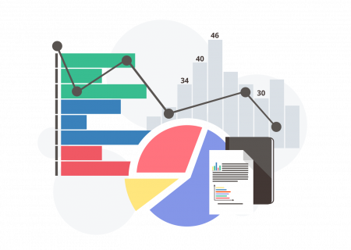
—Dietrich Dorner
“If we want to solve problems effectively...we must keep in mind not only many features but also the influences among them”

Slide 16
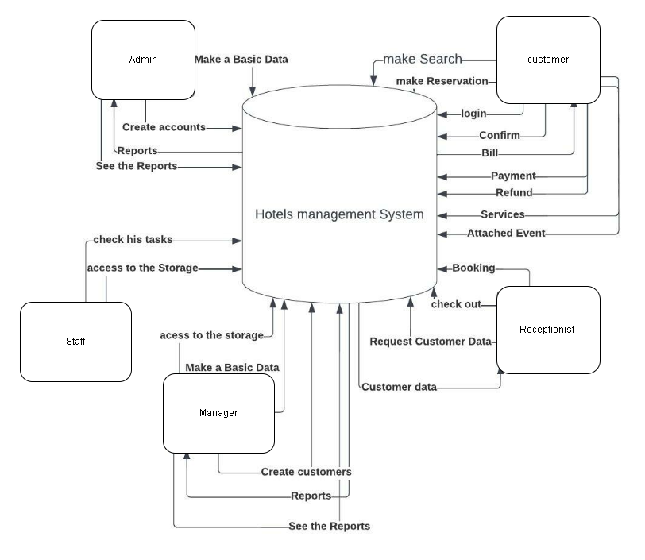
Context Diagram
A context diagram is drawn in order to define and clarify the boundaries of the software system It identifies the flows of information between the system and external entities. The entire software system is shown as a single process

Slide 17
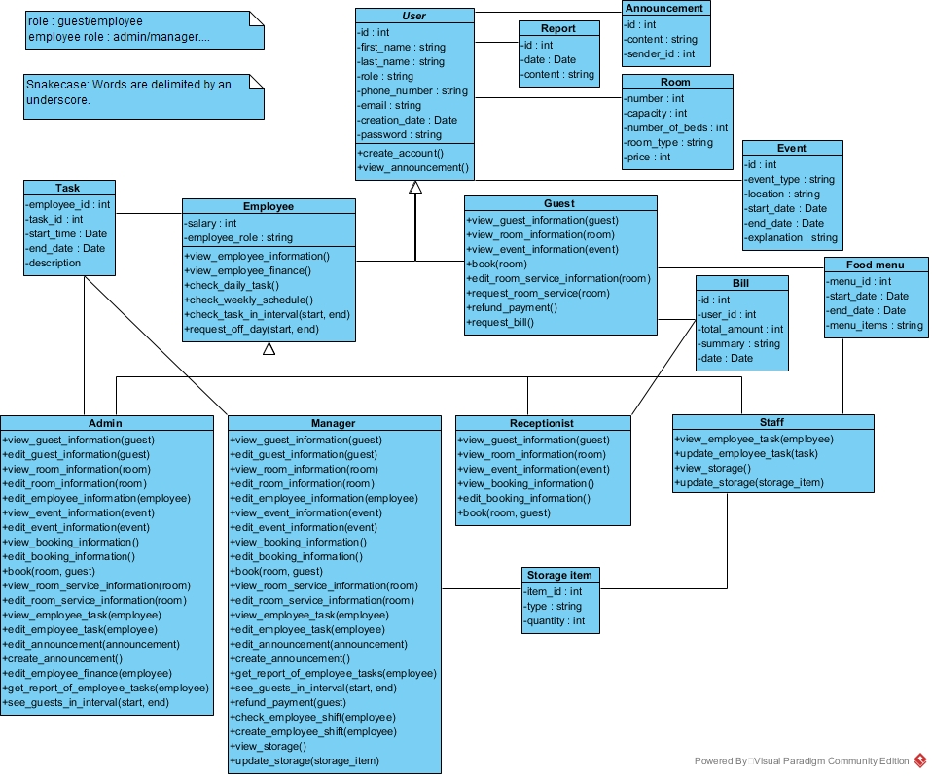
Class Diagram
What is a Class
A description of a group of objects all with similar roles in the system, which consists of:
Structural features (attributes) define what objects of the class "know"
Represent the state of an object of the class
Are descriptions of the structural or static features of a class
Behavioral features (operations) define what objects of the class "can do"
Define the way in which objects may interact
Operations are descriptions of behavioral or dynamic features of a class

Slide 18
Data Flow Diagram
A data flow diagram (DFD) maps out the flow of information for any process or system. It uses defined symbols like rectangles, circles and arrows, plus short text labels, to show data inputs, outputs, storage points and the routes between each destination.

Slide 19

System Design
4

Slide 20
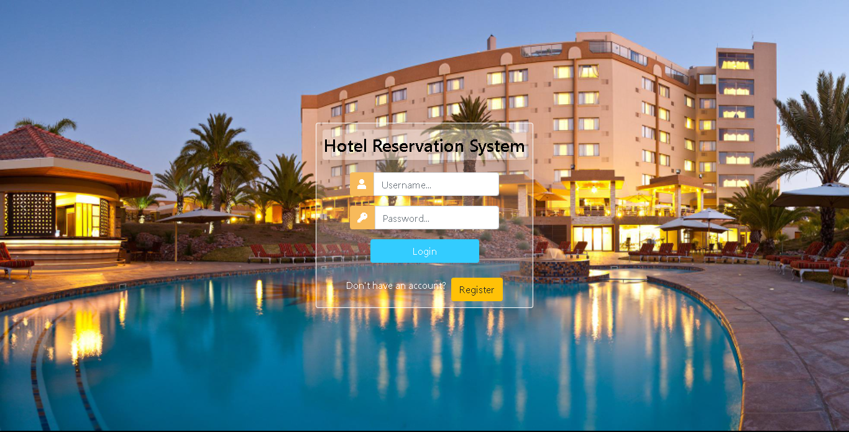
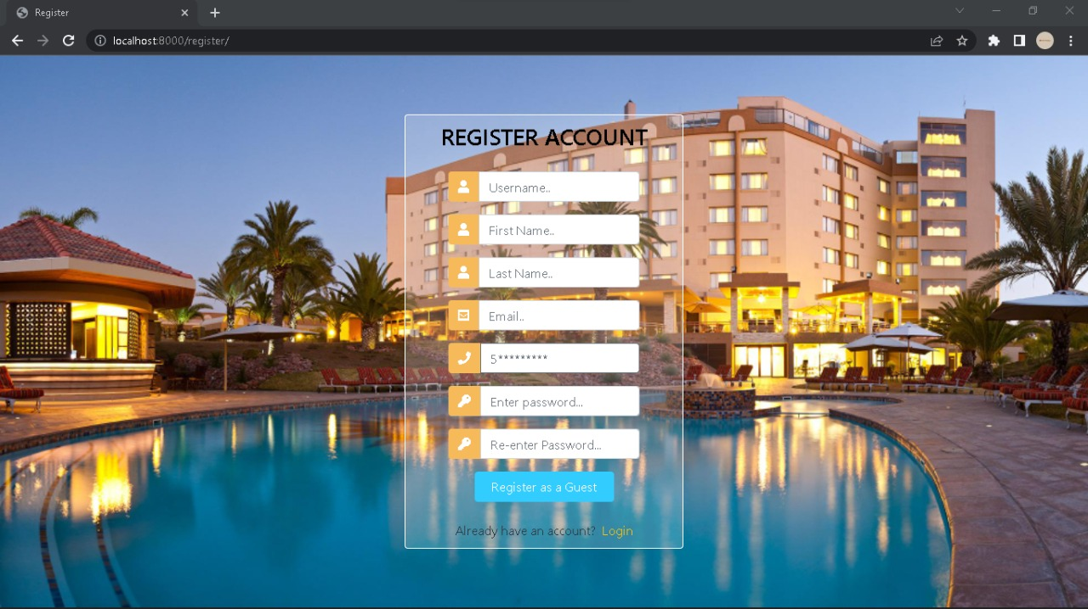
Login & Registration
Note : the Registration Conditions are applied

Slide 21
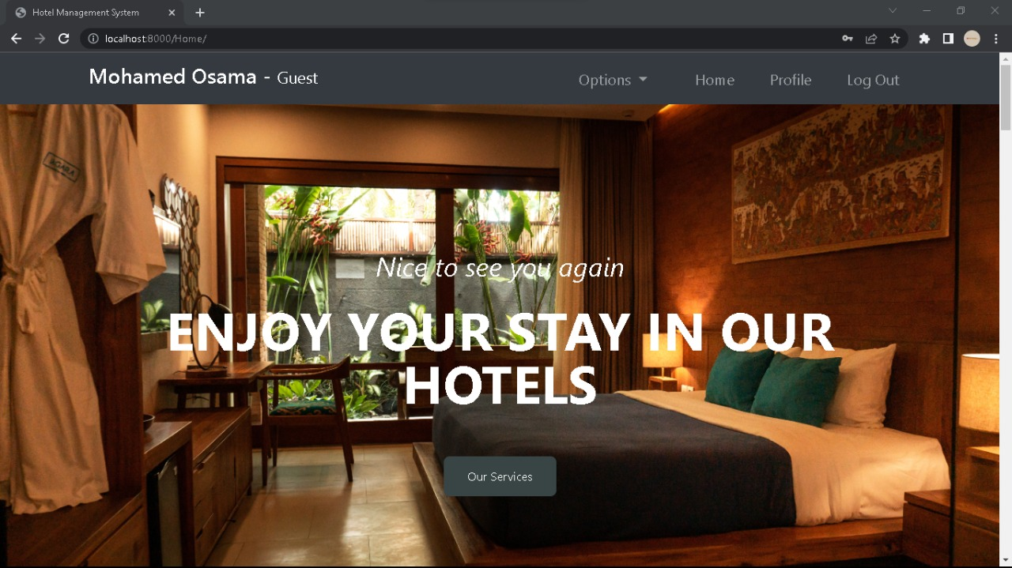
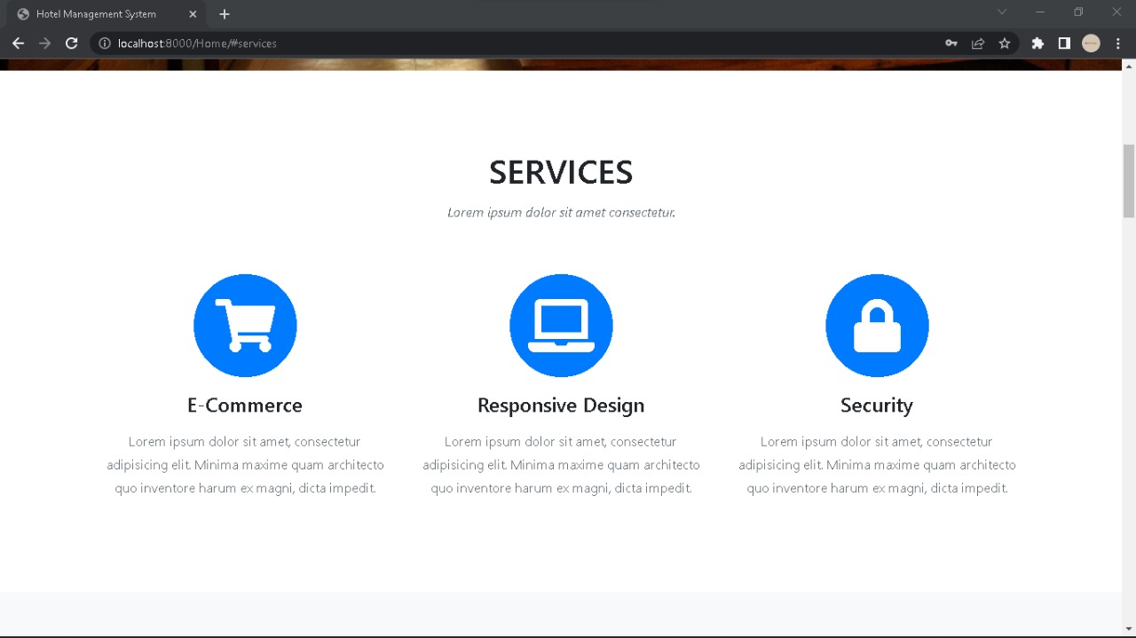
Social Media
This is a Sample, but you can Scroll more in the Home

Slide 22
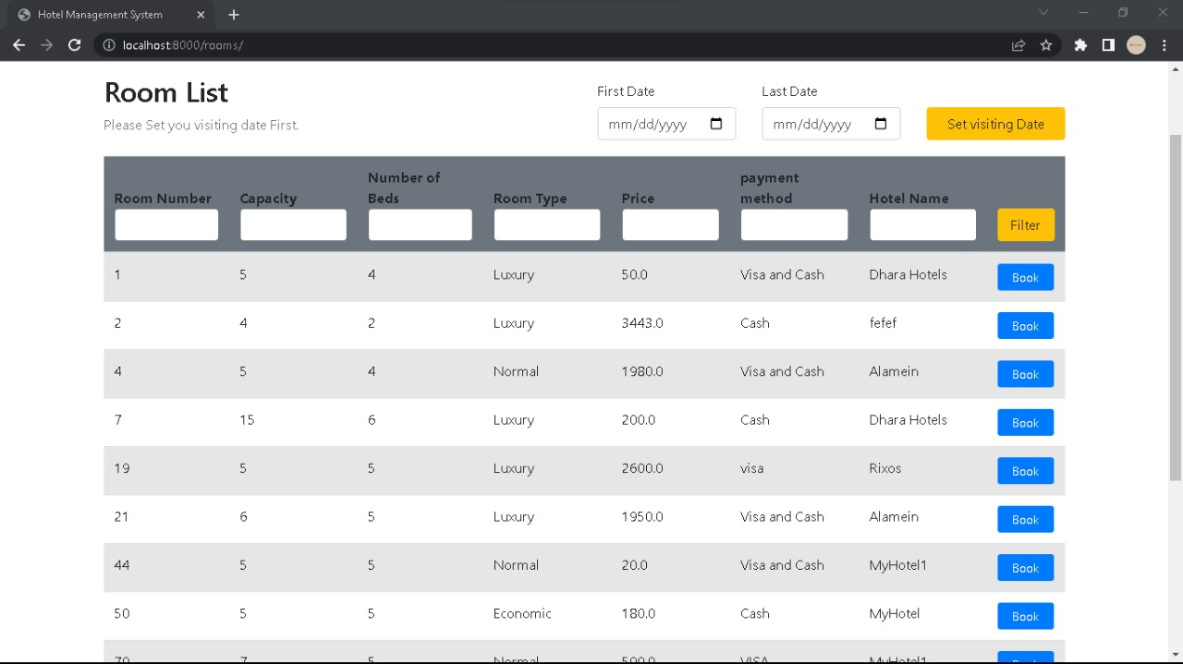
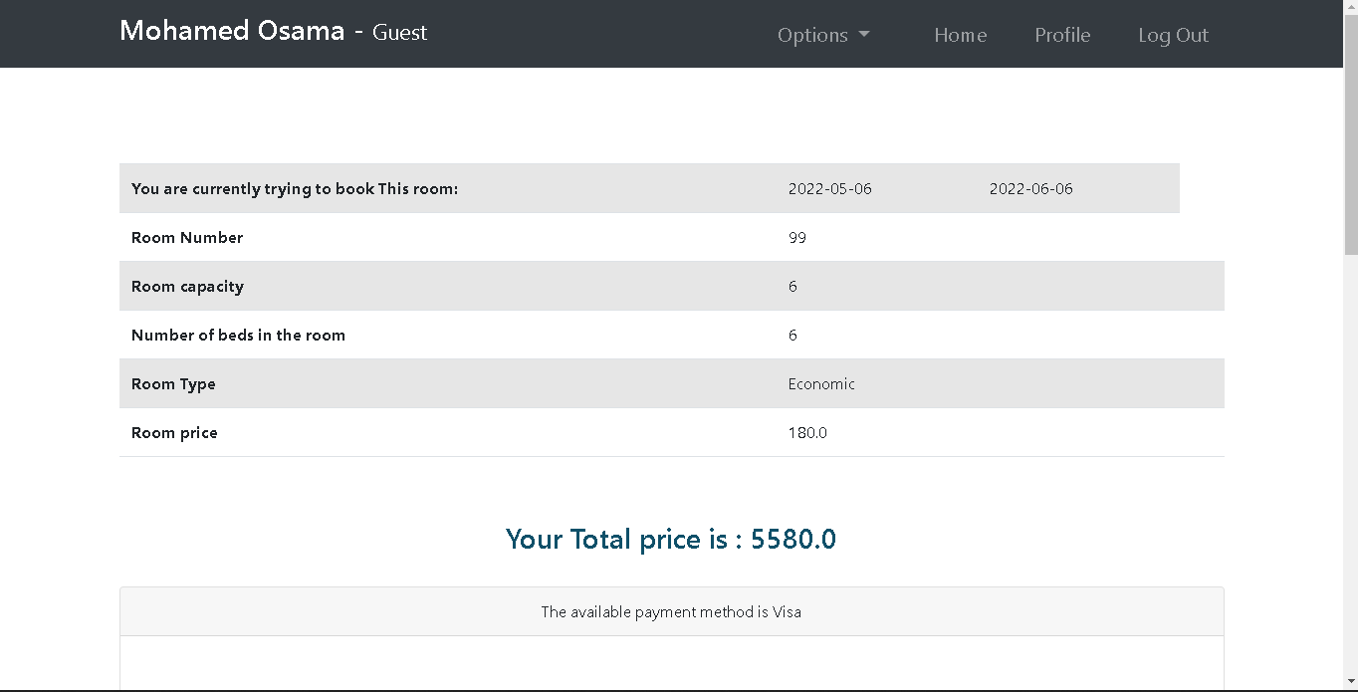
Rooms & Booking
Here you can see all the available roos and Book the one you like

Slide 23

05
Implementation

Slide 24
Implementation software
implementation
Python
Django
SQLite
CSS & JS
The most important software we use
The back-end languague that we use
The platform that’s implement python as BE
Our Database application Built-in into Django
The scripting languaages that we create GUI with

Slide 25
implementation Process
1
2
3
4
5
Code the
Back-end Functionality
Install implementation software
System analysis and Design
Design and implement the Database
Style the Front With CSS/JS

Slide 26

References
06

Slide 27
References &Resources
References
hotel Tec report
Ian Sommerville (2015). Software Engineering, Pearson tenth edition.
Object-Oriented Software Engineering Using UML, Patterns, Prentice Hall
Resource Photos
Tray with breakfast bed
Tray with coffee bed
Person with stack terrycloth towels
Spa medical accessories table
Alarm clock wooden desk bedroom

